Slide 1
Legal Austrian RAG system
Mehdin Masinovic & Leon Beccard
25.04.2025

Slide 2
Agenda
Introduction and Requirements
Project architecture
Experiment Setup
Experiments
Key Findings and Conclusion

Slide 3
Introduction and Requirements

Slide 4
Introduction
Problem
Information about legal Austrian corpus on Viennese building regulations is (currently) too specific for any LLM.
Approach
Consider Retrieval Augmented Generation (RAG) to have a knowledge base to input with the user query and identify optimal configurations towards a provided Q&A dataset by our legal expert.

Slide 5
Introduction
Retrieval Augmented Generation - RAG
Background from LLM limitations to reduce hallucinations and avoid outdated knowledge
Combining retrieval systems with generative AI to improve accuracy and context-relevance in question answering
Key components: Embedding model, Vector database, Chunking strategies, LLM
Hyperparameters in RAG
Embedding model
Reranking model (Cross-Encoder)
Chunking size
Number of best chunks selected
Large Language model

Slide 6
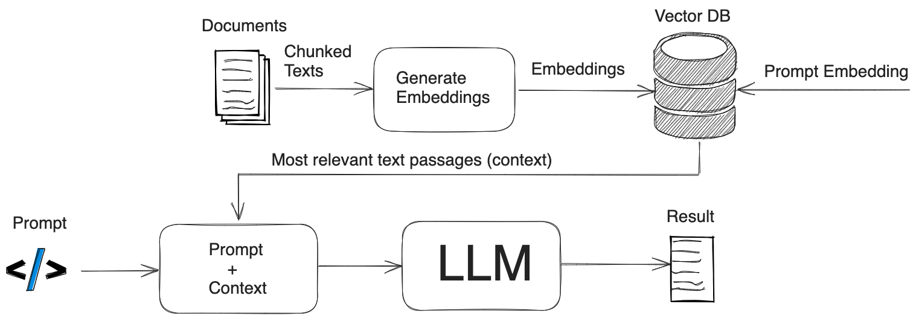
Introduction
Retrieval Augmented Generation - RAG

Slide 7
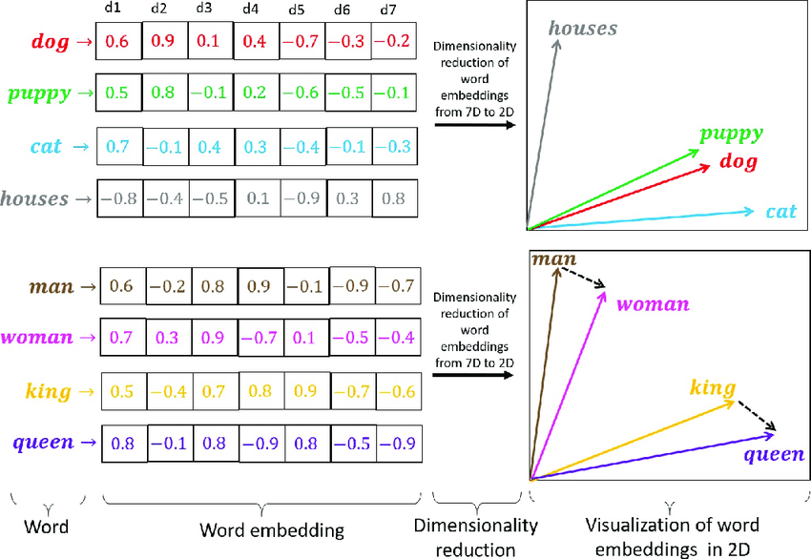
Introduction
Word embeddings

Slide 8
Requirements
External requirements:
Answers have to be in german
Executability without external resources like Cloud Providers or LLMs
Implement methods on your own instead of sophisticated libraries like Langchain
Internal requirements:
Reproducible scientific evaluation on experiments
Executability on a local device in regards of reasonable runtime (<5 minutes)

Slide 9
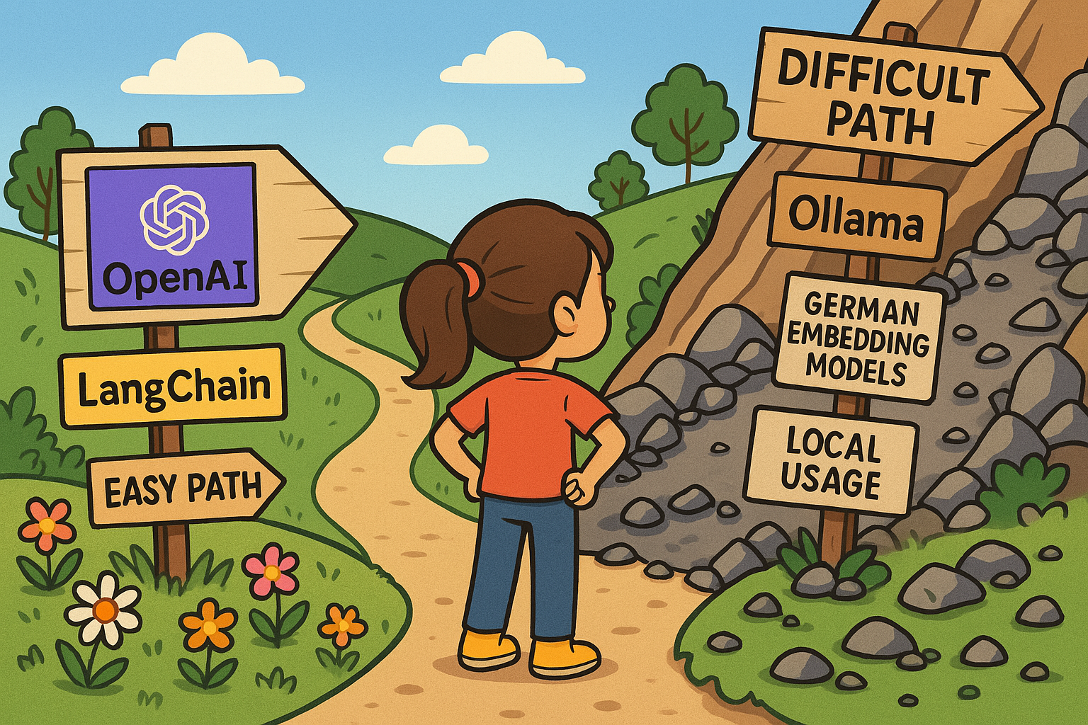
Requirements

Slide 10
Project architecture

Slide 11
Project architecture
Data Source: Viennese building regulation legal text corpus
Dataset: Q&A dataset by legal expert with 11 Q&A pairs
Backend: Python with FastAPI
Vector Database: Elasticsearch
Deployment: Docker container
Evaluation: Deepeval, Individual evaluation method
Embedding model: jinaai/jina-embeddings-v2-base-de
Cross Encoder: cross-encoder/msmarco-MiniLM-L12-en-de-v1
LLM: gemma3:27b

Slide 12
Project architecture
Workflow
Load legal text document
Chunk text using different strategies and sizes
Generate embeddings for each chunk
Index chunks in Elasticsearch
Embed user query, retrieve relevant chunks, rerank with cross-encoder
Pass context to LLM for final answer generation
Evaluate with our evaluation methods and reference answers

Slide 13
Project architecture
LLM-as-a-judge - Evaluation with Deepeval
Answer Correctness: Accuracy of the generated response
Answer Relevance: How well the answer addresses the query
Context Quality: Relevance and usefulness of retrieved context
Faithfulness to Context: Whether the answer stays true to the retrieved information
Combined Score: Aggregate metric reflecting overall performance
Individual Evaluation based on Keywords
Score measurement: Find the important keywords in answers or contexts like a paragraph number
Answer/Retrieval score: Binary score of 0 or 1 if keyword is found
Total score: Maximum of 11 points possible per Q&A pair

Slide 14
Experiment Setup

Slide 15
Experiment Setup
Hardware Setup 1: Lenovo Thinkpad Gen2 32GB RAM Intel Core i7 - CPU only
Hardware Setup 2: Running on Server with GPU Nvidia GeForce GTX 660
Comparing Embedding models
jinaai/jina-embeddings-v2-base-de vs. paraphrase-multilingual-MiniLM-L12-v2
Comparing chunk size
Multiple sizes from 0,125 kB to 128 kB
Comparing LLM models
llama3-chatqa:8b vs. gemma3:27b
Comparing chunking method
Splitting at maximum chunk size vs. splitting by article vs. splitting by subarticle
Comparing number of selected chunks
Picking the best chunk vs. top 3 best chunks vs. top 5 best chunks

Slide 16
Experiments

Slide 17
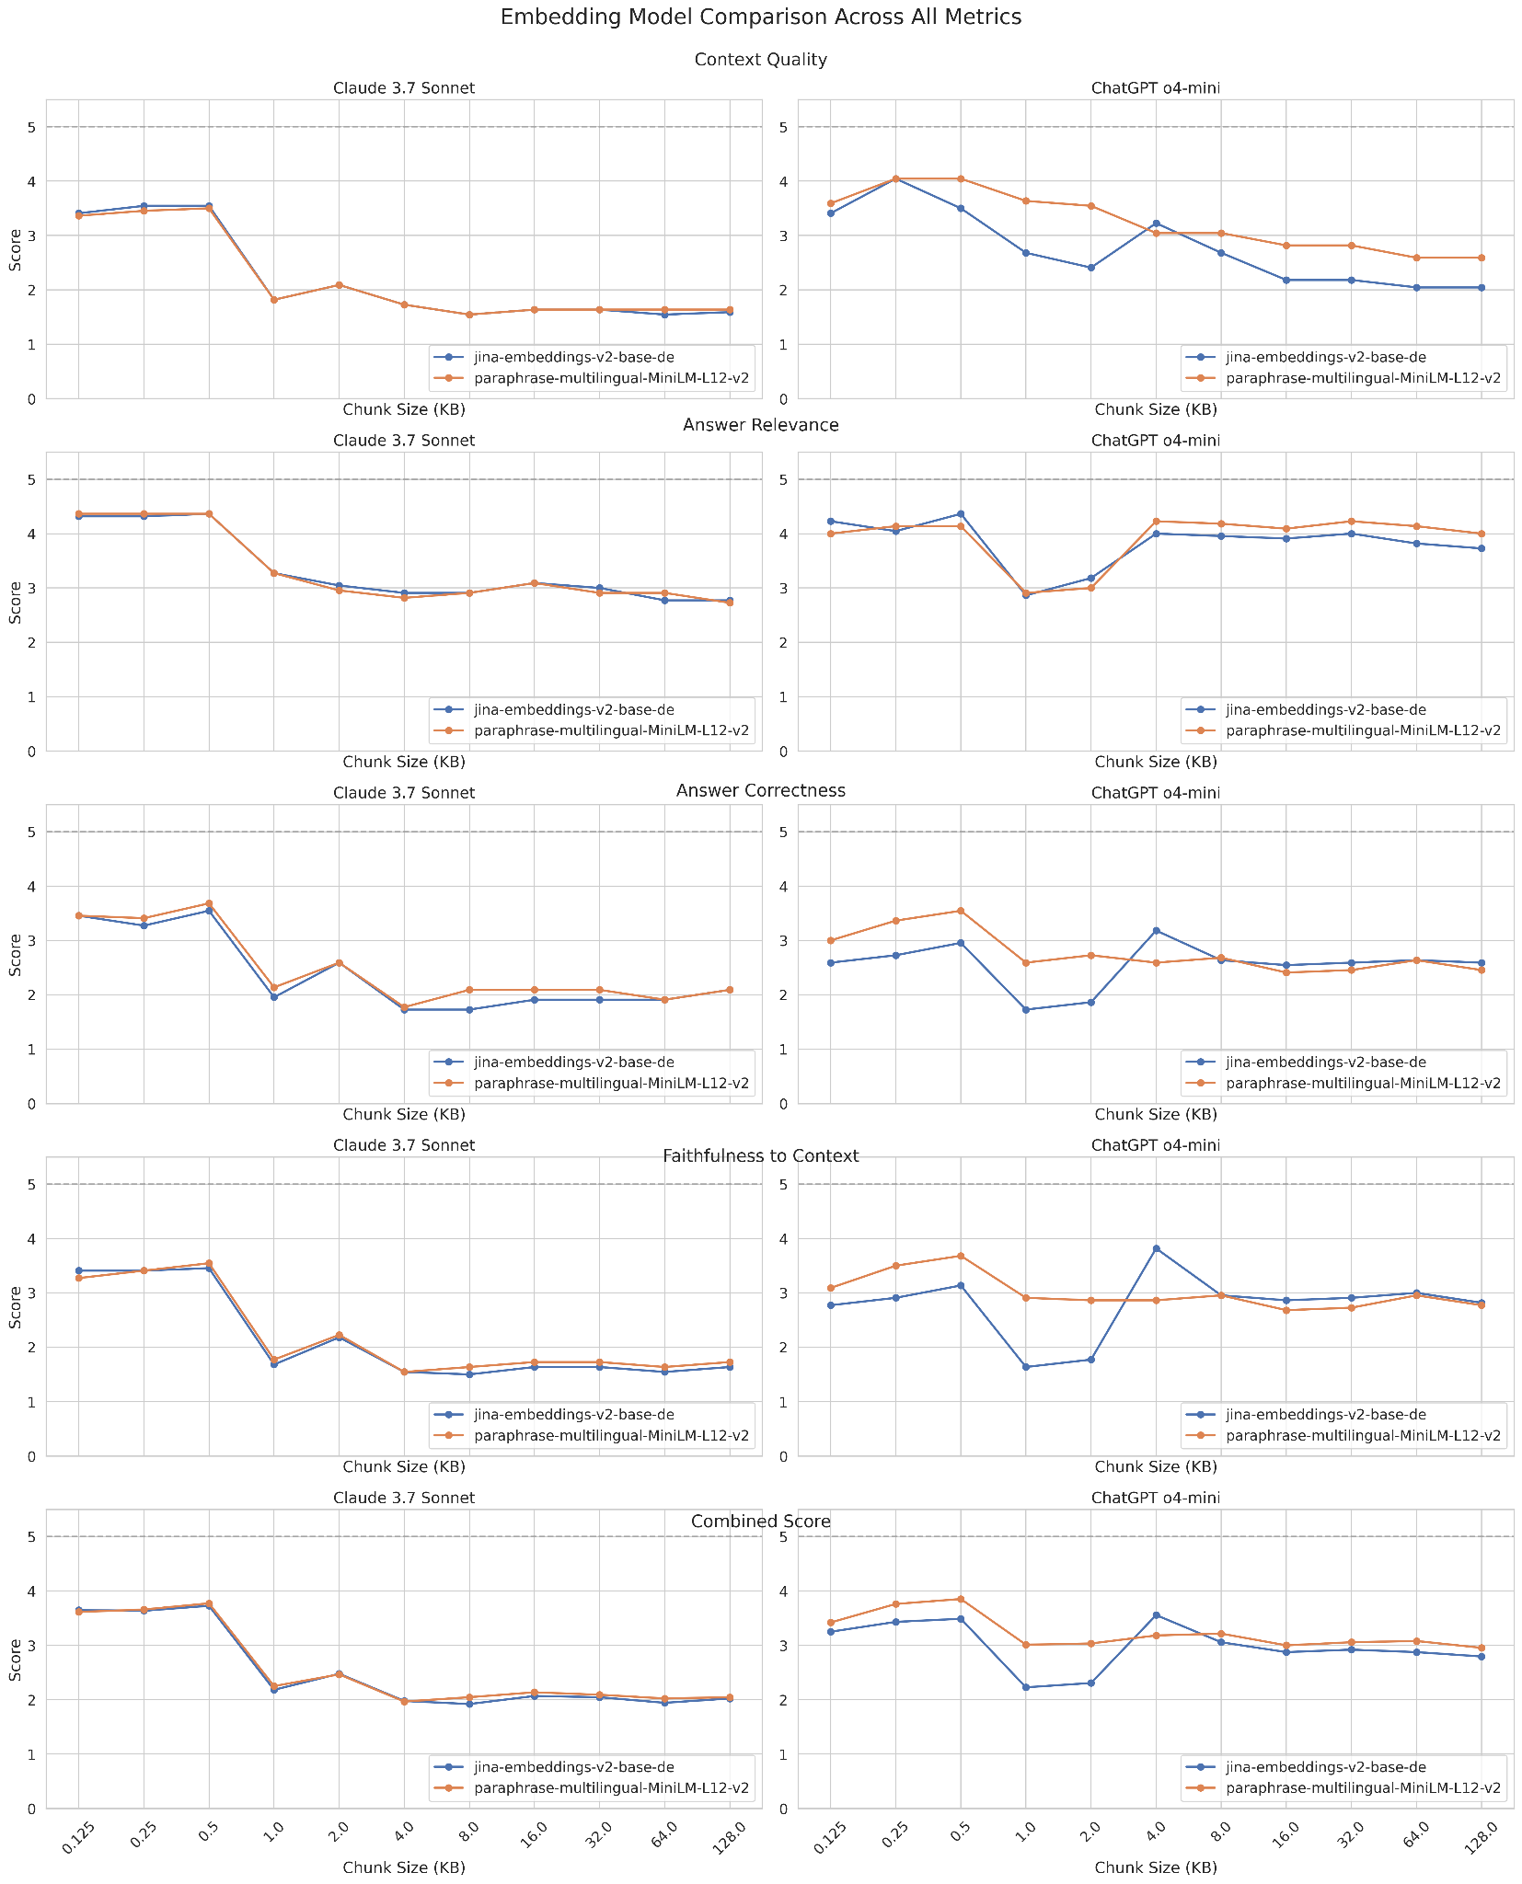
Experiments
Embedding models
Both models show similar performance patterns
Small chunks (0.125KB - 0.5KB) deliver best overall performance
Significant performance drop at 1.0KB chunk size
jina-embeddings model shows more consistent patterns

Slide 18
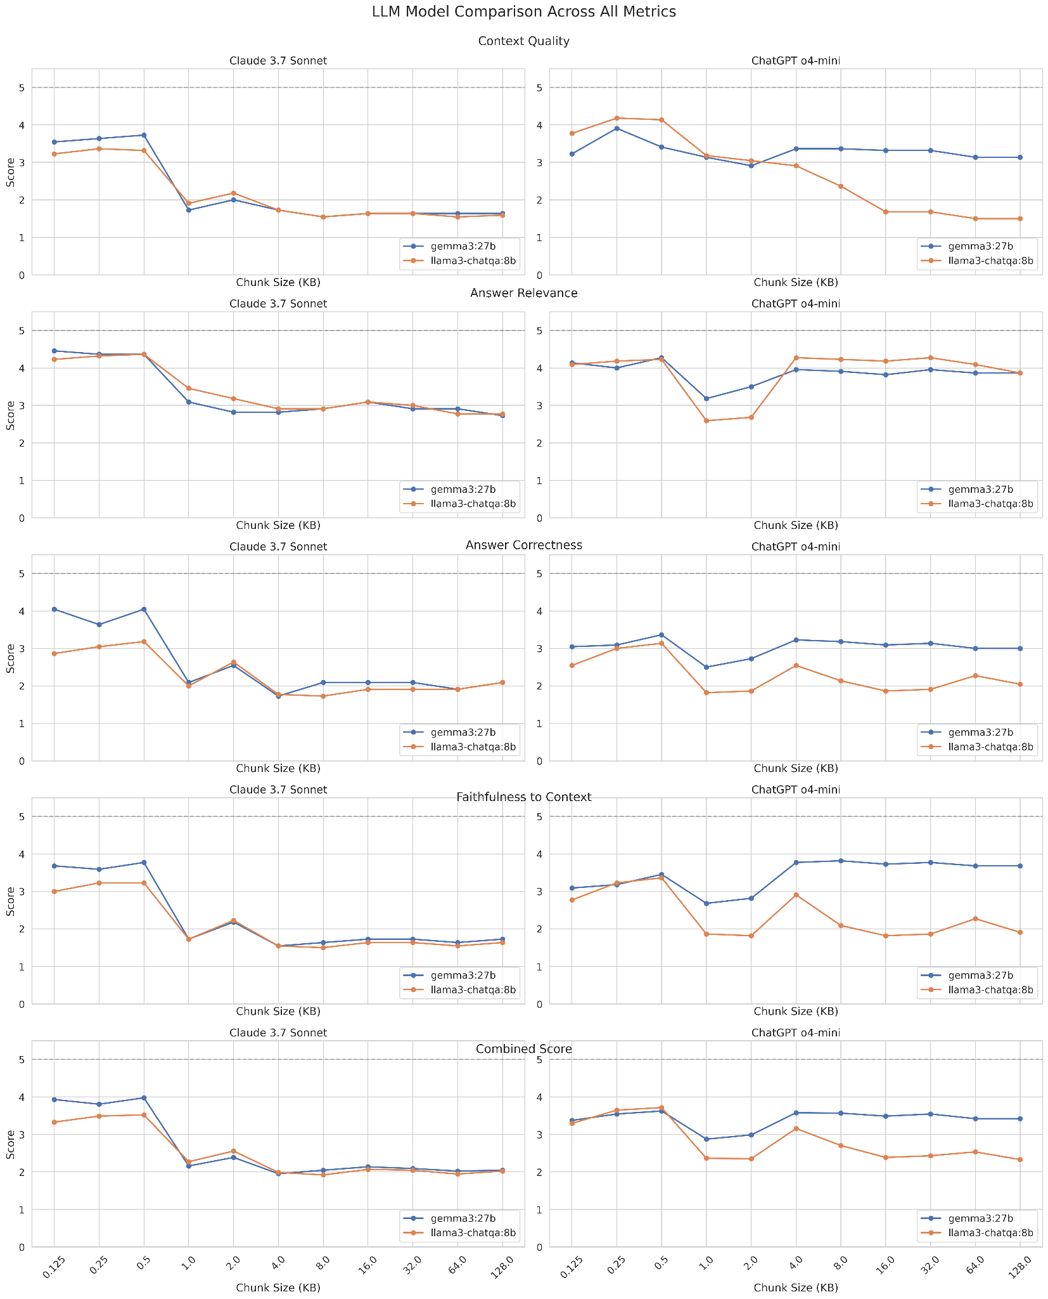
Experiments
Large Language models
gemma3:27b generally outperforms llama3-chatqa:8b
Both models show similar response to chunking strategies
Optimal chunk size consistent across both models (0.5KB)
Performance gap consistent across different metrics

Slide 19
Experiments
Small chunks (0.125KB - 0.5KB):
Highest performance across all metrics
Better context quality
Improved answer relevance
Medium chunks (1KB - 4KB):
Performance drop, especially in context quality
Varied impact on faithfulness
Large chunks (8KB+):
Lowest overall performance
Poor context quality
Lower answer correctness

Slide 20
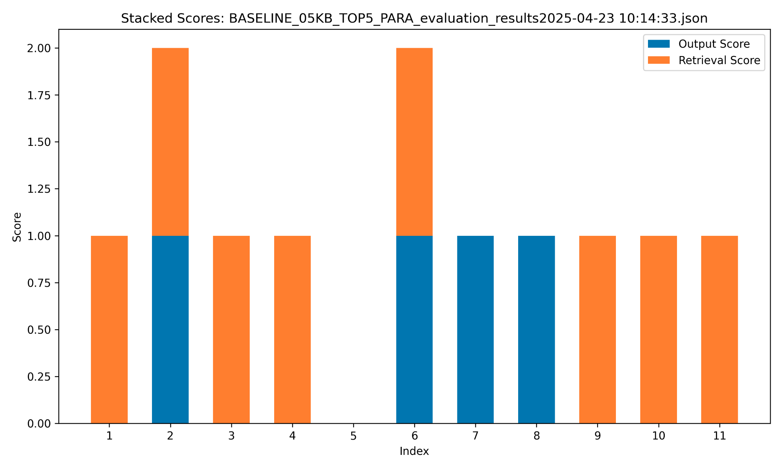
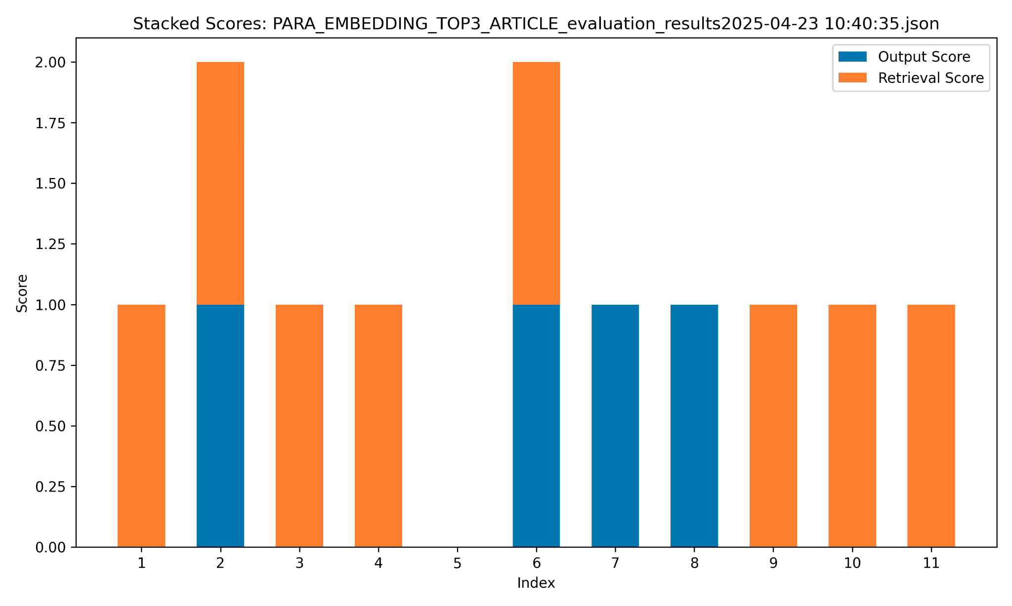
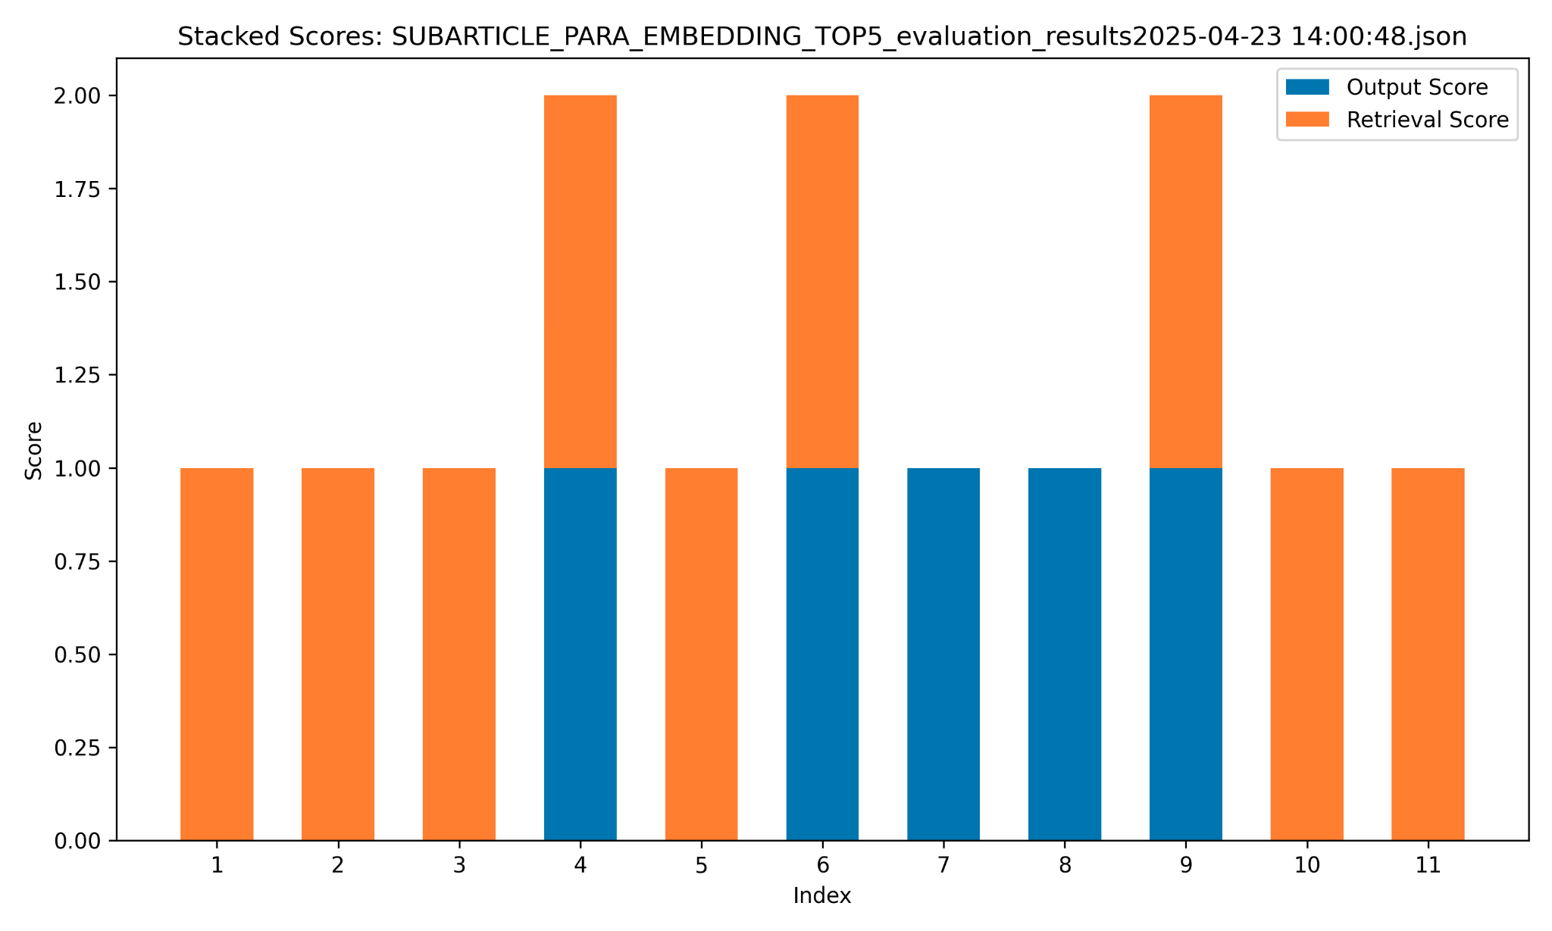
Experiments
Chunking splitting method
Baseline with splitting at 0,5 KB
Splitting at each article with top 3 chunks
Splitting at each subarticle with top 5 chunks

Slide 21
Experiments
Chunking splitting method
Baseline with splitting at 0,5 KB
Splitting at each article with top 3 chunks
Splitting at each subarticle with top 5 chunks

Slide 22
Key findings

Slide 23
Key findings
Small chunks (0.125KB - 0.5KB):
Highest performance across all metrics
Better context quality
Improved answer relevance
Medium chunks (1KB - 4KB):
Performance drop, especially in context quality
Varied impact on faithfulness
Large chunks (8KB+):
Lowest overall performance
Poor context quality
Lower answer correctness

Slide 24
Conclusion

Slide 25
Key findings
Small chunks (0.125KB - 0.5KB):
Highest performance across all metrics
Better context quality
Improved answer relevance
Medium chunks (1KB - 4KB):
Performance drop, especially in context quality
Varied impact on faithfulness
Large chunks (8KB+):
Lowest overall performance
Poor context quality
Lower answer correctness

Slide 26
Thank you for your attention!
Any questions?

